Slide 1

Copyright © www.ITbodhi.com

Slide 2
‘Naive Bayes‘, which can be extremely, fast relative to other classification algorithms, It is a classification technique based on Bayes’ Theorem with an assumption of independence among predictors.
Naive Bayes model is easy to build and particularly useful for very large data sets.
Along with simplicity, Naive Bayes is known to outperform even highly sophisticated classification methods.
Copyright © www.ITbodhi.com

Slide 3
The Bayes Rule
The Bayes Rule provides the formula for the probability of Y given X. But, in real-world problems, you typically have multiple X variables.
When the features are independent, we can extend the Bayes Rule to what is called Naive Bayes. It is called ‘Naive’ because of the naive assumption that the X’s are independent of each other.
The Bayes Rule is a way of going from P(X|Y), known from the training dataset, to find P(Y|X).
For observations in train data, the X and Y would be known.
For observations in test data, the X would be known while Y is unknown. And for each row of the test dataset, you want to compute the probability of Y given the X has already happened.
What happens if Y has more than 2 categories? We compute the probability of each class of Y and let the highest win.
Copyright © www.ITbodhi.com

Slide 4
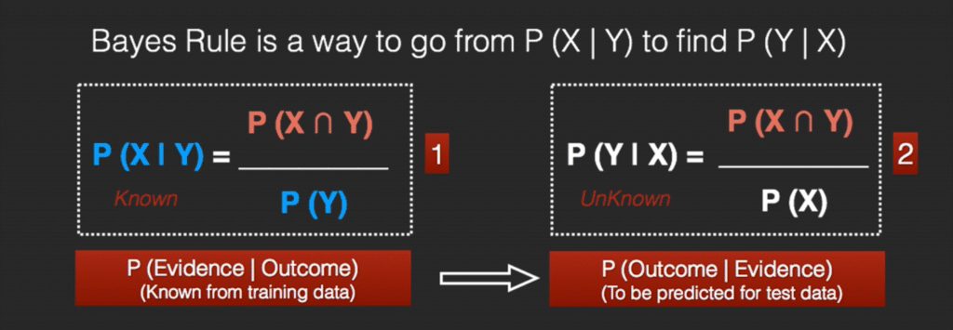
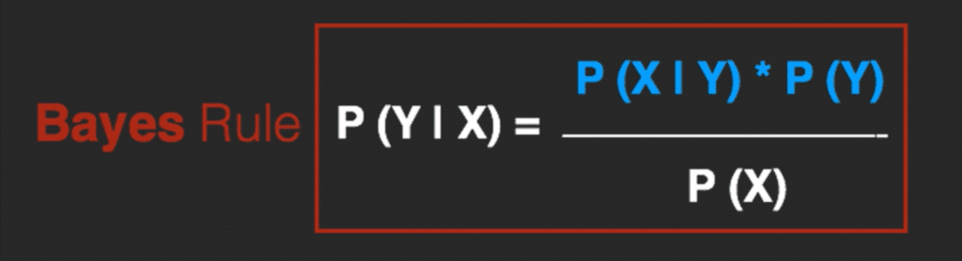
Copyright © www.ITbodhi.com

Slide 5
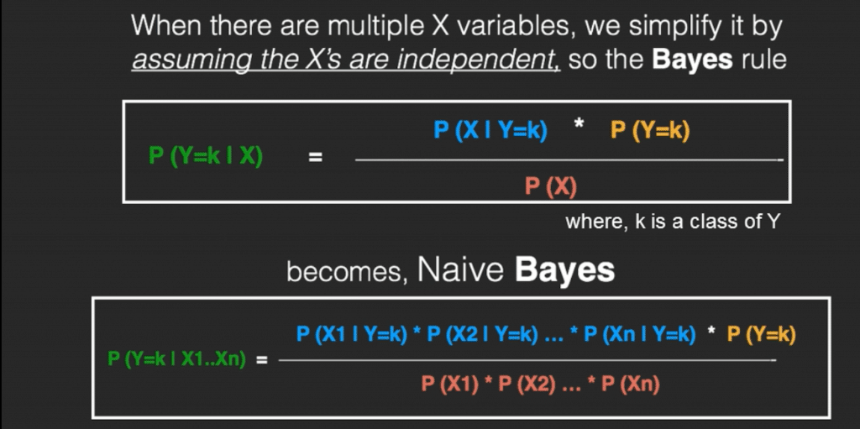
Copyright © www.ITbodhi.com

Slide 6
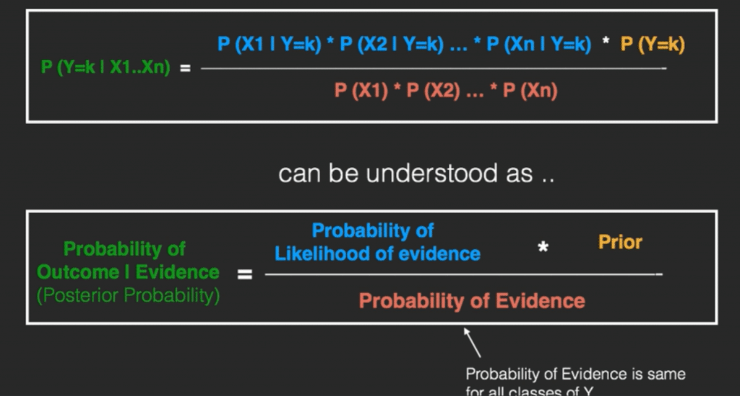
Copyright © www.ITbodhi.com

Slide 7
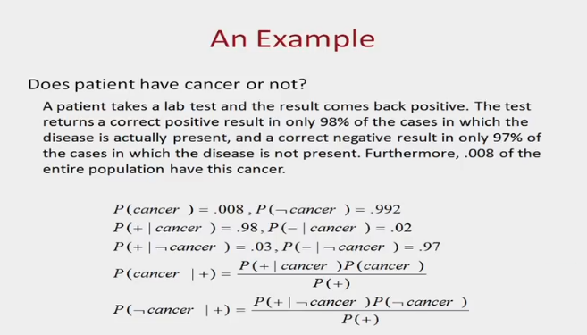
Copyright © www.ITbodhi.com

Slide 8
Naive Bayes Example by Hand
Say you have 1000 fruits which could be either ‘banana’, ‘orange’ or ‘other’. These are the 3 possible classes of the Y variable.
We have data for the following X variables, all of which are binary (1 or 0).
Long
Sweet
Yellow
The first few rows of the training dataset look like this:
Fruit | Long (x1) | Sweet (x2) | Yellow (x3)
Orange | 0 | 1 | 0
Banana | 1 | 0 | 1
Banana | 1 | 1 | 1
Other | 1 | 1 | 0
.. | .. | .. | ..
Copyright © www.ITbodhi.com

Slide 9
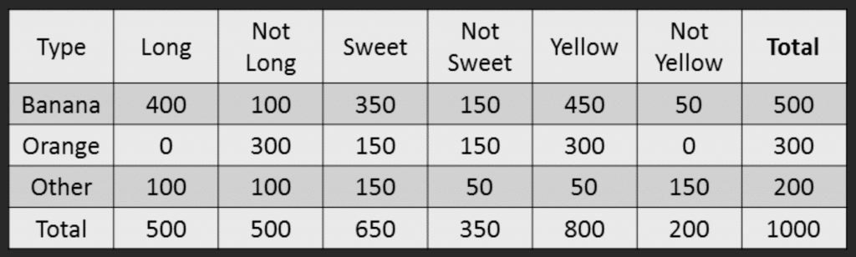
For the sake of computing the probabilities, let’s aggregate the training data to form a counts table like this.
Copyright © www.ITbodhi.com

Slide 10
Step 1: Compute the ‘Prior’ probabilities for each of the class of fruits.
That is, the proportion of each fruit class out of all the fruits from the population. You can provide the ‘Priors’ from prior information about the population. Otherwise, it can be computed from the training data.
For this case, let’s compute from the training data. Out of 1000 records in training data, you have 500 Bananas, 300 Oranges and 200 Others. So the respective priors are 0.5, 0.3 and 0.2.
P(Y=Banana) = 500 / 1000 = 0.50
P(Y=Orange) = 300 / 1000 = 0.30
P(Y=Other) = 200 / 1000 = 0.20
Copyright © www.ITbodhi.com

Slide 11
Step 2: Compute the probability of evidence that goes in the denominator.
This is nothing but the product of P of Xs for all X. This is an optional step because the denominator is the same for all the classes and so will not affect the probabilities.
P(x1=Long) = 500 / 1000 = 0.50
P(x2=Sweet) = 650 / 1000 = 0.65
P(x3=Yellow) = 800 / 1000 = 0.80
Copyright © www.ITbodhi.com

Slide 12
Step 3: Compute the probability of likelihood of evidences that goes in the numerator.
It is the product of conditional probabilities of the 3 features. If you refer back to the formula, it says P(X1 |Y=k). Here X1 is ‘Long’ and k is ‘Banana’. That means the probability the fruit is ‘Long’ given that it is a Banana. In the above table, you have 500 Bananas. Out of that 400 is long. So, P(Long | Banana) = 400/500 = 0.8.
Here, I have done it for Banana alone.
Probability of Likelihood for Banana
P(x1=Long | Y=Banana) = 400 / 500 = 0.80
P(x2=Sweet | Y=Banana) = 350 / 500 = 0.70
P(x3=Yellow | Y=Banana) = 450 / 500 = 0.90
So, the overall probability of Likelihood of evidence for Banana = 0.8 * 0.7 * 0.9 = 0.504
Copyright © www.ITbodhi.com

Slide 13
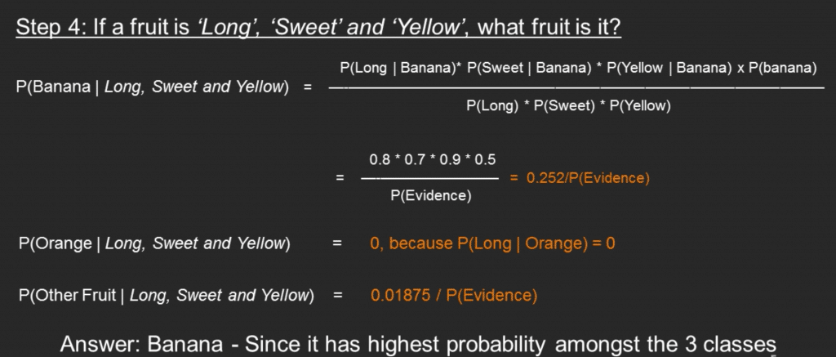
Step 3: Compute the probability of likelihood of evidences that goes in the numerator.
It Step 4: Substitute all the 3 equations into the Naive Bayes formula, to get the probability that it is a banana.
Copyright © www.ITbodhi.com

Slide 14
What is Laplace Correction?
The value of P(Orange | Long, Sweet and Yellow) was zero in the above example, because, P(Long | Orange) was zero. That is, there were no ‘Long’ oranges in the training data.
It makes sense, but when you have a model with many features, the entire probability will become zero because one of the feature’s value was zero. To avoid this, we increase the count of the variable with zero to a small value (usually 1) in the numerator, so that the overall probability doesn’t become zero.
This correction is called ‘Laplace Correction’. Most Naive Bayes model implementations accept this or an equivalent form of correction as a parameter.
Copyright © www.ITbodhi.com

Slide 15
Types of Naive Bayes Classifier
There are three types of Naive Bayes model under scikit learn library:
1. Multinomial Naive Bayes: It is used for discrete counts when category are more than 2.
This is mostly used for document classification problem, i.e whether a document belongs to the category of sports, politics, technology etc. The features/predictors used by the classifier are the frequency of the words present in the document. Ex. Term Frequency –or Inverse Document Frequency (Tf-idf)
2. Bernoulli Naive Bayes:
This is similar to the multinomial naive bayes but the predictors are binary variables(0 or 1). The parameters that we use to predict the class variable take up only values yes or no, for example if a word occurs in the text or not. One application would be text classification with ‘bag of words’ model where the 1s & 0s are “word occurs in the document” and “word does not occur in the document” respectively.
3. Gaussian Naive Bayes:
When the predictors take up a continuous value and are not discrete, we assume that these values are sampled from a gaussian distribution.
Copyright © www.ITbodhi.com

Slide 16
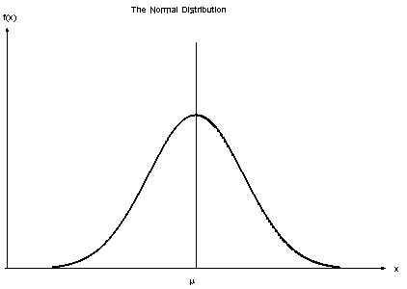
Gaussian Naive Bayes Continued….
Numerical variables need to be transformed to their categorical counterparts before constructing their frequency tables.
The other option we have is, using the distribution of the numerical variable to have a good guess of the frequency.
For example, one common practice is to assume normal
distributions for numerical variables.
The probability density function for the normal
distribution is defined by two parameters
(mean and standard deviation)
Copyright © www.ITbodhi.com

Slide 17
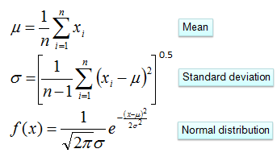
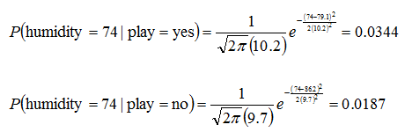
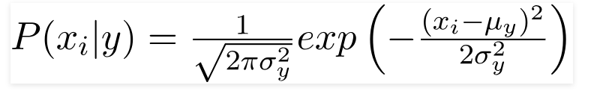
 |  | Humidity |  |  |  |  |  |  |  |  | Mean | StDev
Play Golf | yes | 86 | 96 | 80 | 65 | 70 | 80 | 70 | 90 | 75 | 79.1 | 10.2
 | no | 85 | 90 | 70 | 95 | 91 |  |  |  |  | 86.2 | 9.7
Copyright © www.ITbodhi.com

Slide 18
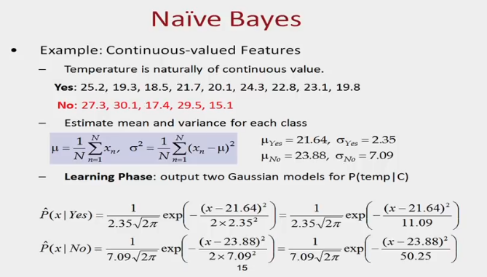
Copyright © www.ITbodhi.com

Slide 19
What are the Pros and Cons of Naive Bayes?
Pros:
It is easy and fast to predict class of test data set. It also perform well in multi class prediction
When assumption of independence holds, a Naive Bayes classifier performs better compare to other models like logistic regression and you need less training data.
It perform well in case of categorical input variables compared to numerical variable(s). For numerical variable, normal distribution is assumed (bell curve, which is a strong assumption).
Cons:
If categorical variable has a category (in test data set), which was not observed in training data set, then model will assign a 0 (zero) probability and will be unable to make a prediction. This is often known as “Zero Frequency”. To solve this, we can use the smoothing technique. One of the simplest smoothing techniques is called Laplace estimation.
Another limitation of Naive Bayes is the assumption of independent predictors. In real life, it is almost impossible that we get a set of predictors which are completely independent.
Copyright © www.ITbodhi.com

Slide 20
Applications of Naive Bayes Algorithms
Real time Prediction: Naive Bayes is an eager learning classifier and it is sure fast. Thus, it could be used for making predictions in real time.
Multi class Prediction: This algorithm is also well known for multi class prediction feature. Here we can predict the probability of multiple classes of target variable.
Text classification/ Spam Filtering/ Sentiment Analysis: Naive Bayes classifiers mostly used in text classification (due to better result in multi class problems and independence rule) have higher success rate as compared to other algorithms. As a result, it is widely used in Spam filtering (identify spam e-mail) and Sentiment Analysis (in social media analysis, to identify positive and negative customer sentiments)
Recommendation System: Naive Bayes Classifier and Collaborative Filtering together builds a Recommendation System that uses machine learning and data mining techniques to filter unseen information and predict whether a user would like a given resource or not
Medical diagnosis: Well suited for disease diagnosis
Weather prediction:
Copyright © www.ITbodhi.com

Slide 21
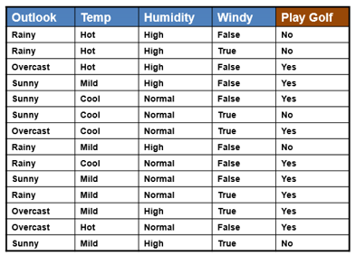
How Naive Bayes algorithm works? Example 2.
Copyright © www.ITbodhi.com

Slide 22
First, constructing a frequency table for each attribute against the target. Then, transforming the frequency tables to likelihood tables and finally use the Naive Bayesian equation to calculate the posterior probability for each class. The class with the highest posterior probability is the outcome of prediction.
Copyright © www.ITbodhi.com

Slide 23
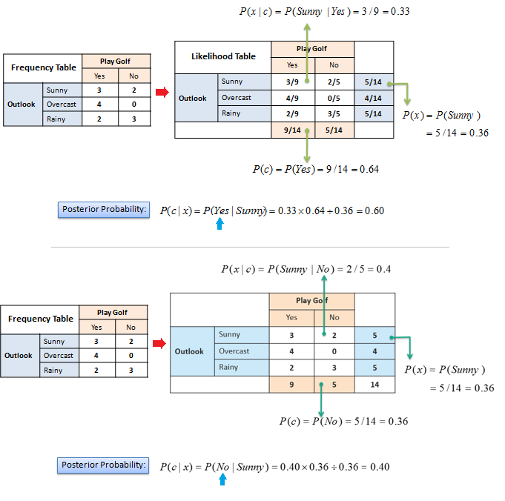
Copyright © www.ITbodhi.com

Slide 24
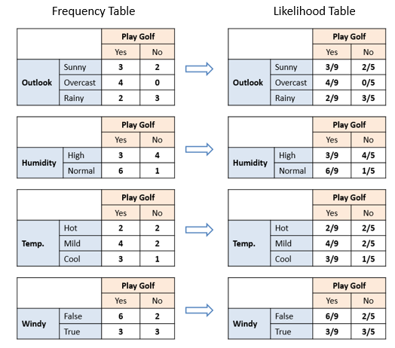
Copyright © www.ITbodhi.com

